Slide 1
Iteration 2: ICS 499
Ans Khan, Muhammad Sohail, Abdul Hazari

Slide 2
Transaction for Non-Profit Organization

Slide 3
Iteration 2
-- Introduction, Scope, Requirements, Goals
- Use case Diagram, Class Diagram and Sequence Diagram
- The UI for the new code (demo of working code)
- Project plan
- Project log

Slide 4
Introduction
The system concerns with an application that does transaction management for any non-profit organisation, that gets funding from individuals.
Any non-profit organisation can be chosen and money can transferred to that specific organisation or NGO.
Transaction can only be processed by adding or selecting credit cards

Slide 5
Scope
The donors or users will add their credit cards, organisation name which they want to donate to and the amount to be donated so that they can make the transaction to the organisation.
e organisation.

Slide 6
Software Development Methodologies
We will be using Java in the eclipse environment for back-end part of it, to develop this software and its functionalities.
A GUI will be created in which all the functionalities will be implemented, HTML is going to be used for the front end part it.

Slide 7
Proposed System Functionalities
The system will contain these functionalities:
Sign up and Sign in.
Pick an organization of their choice.
Amount of money they want to donate.
Choose the Payment Method.
Make the payment.
Get the confirmation after making the payment.

Slide 8
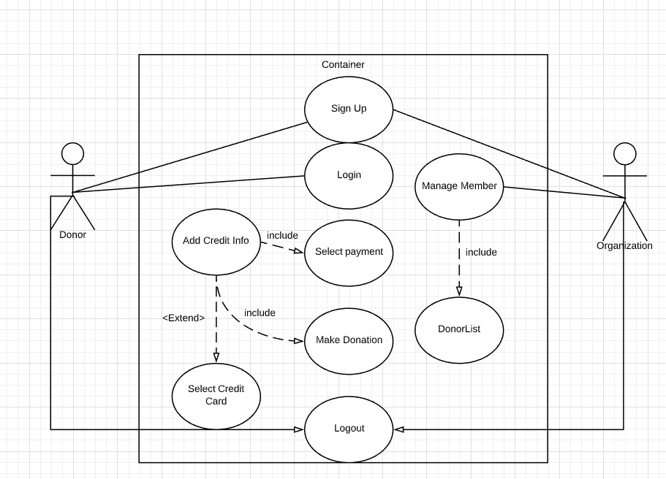
Use Cases

Slide 9
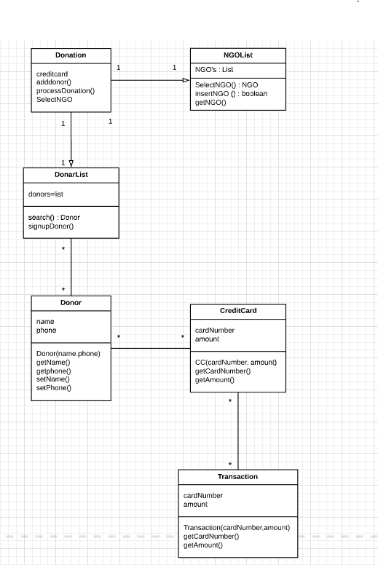
Class Diagram

Slide 10
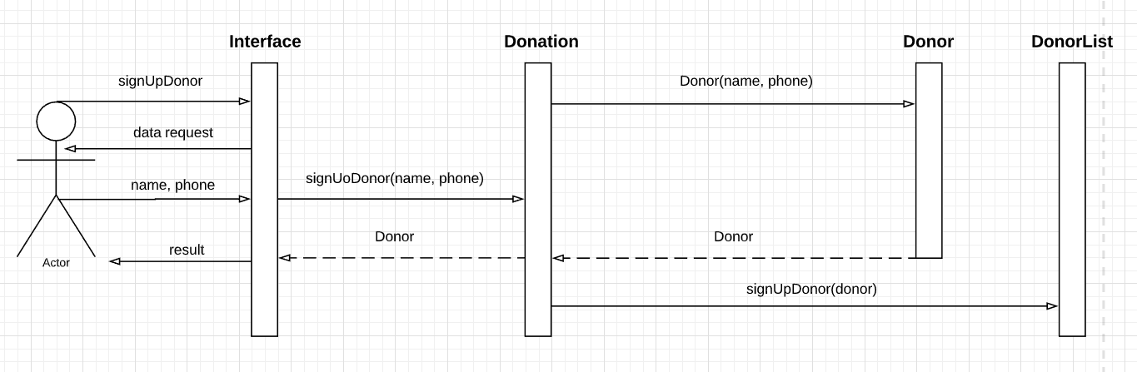
Sequence Diagram: Donor Sign-up

Slide 11
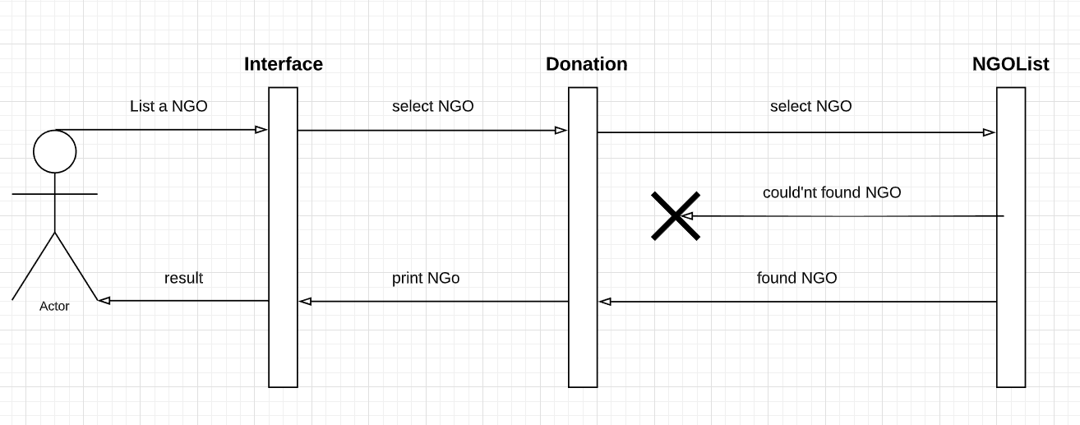
Sequence Diagram: List a NGO

Slide 12
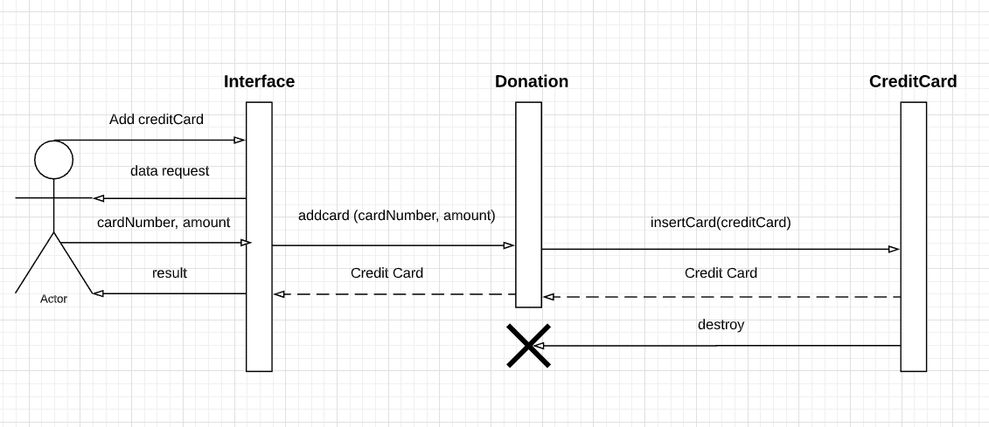
Sequence Diagram: Add Credit Card

Slide 13
Project Plan
In this project the implementation plan for front end is being designed by Muhammad Sohail and back end is done by Ans Khan and Abdul Hazari.
This is the plan until the next presentation and also will work on the diagrams and documentation.

Slide 14
Project Log
09/14/2019 | Met the first time and worked on what we will be doing for the project.
09/15/2019 | Assigned the project duties to what each person will be doing.
09/27/2019 | Worked on sequence diagrams.
10/03/2019 | Worked on the front end code and back end (User Interface)
10/08/2019 | Worked on making the iteration.

Slide 15
Github
https://github.com/anskhan24/ICS-499-Project

Slide 16
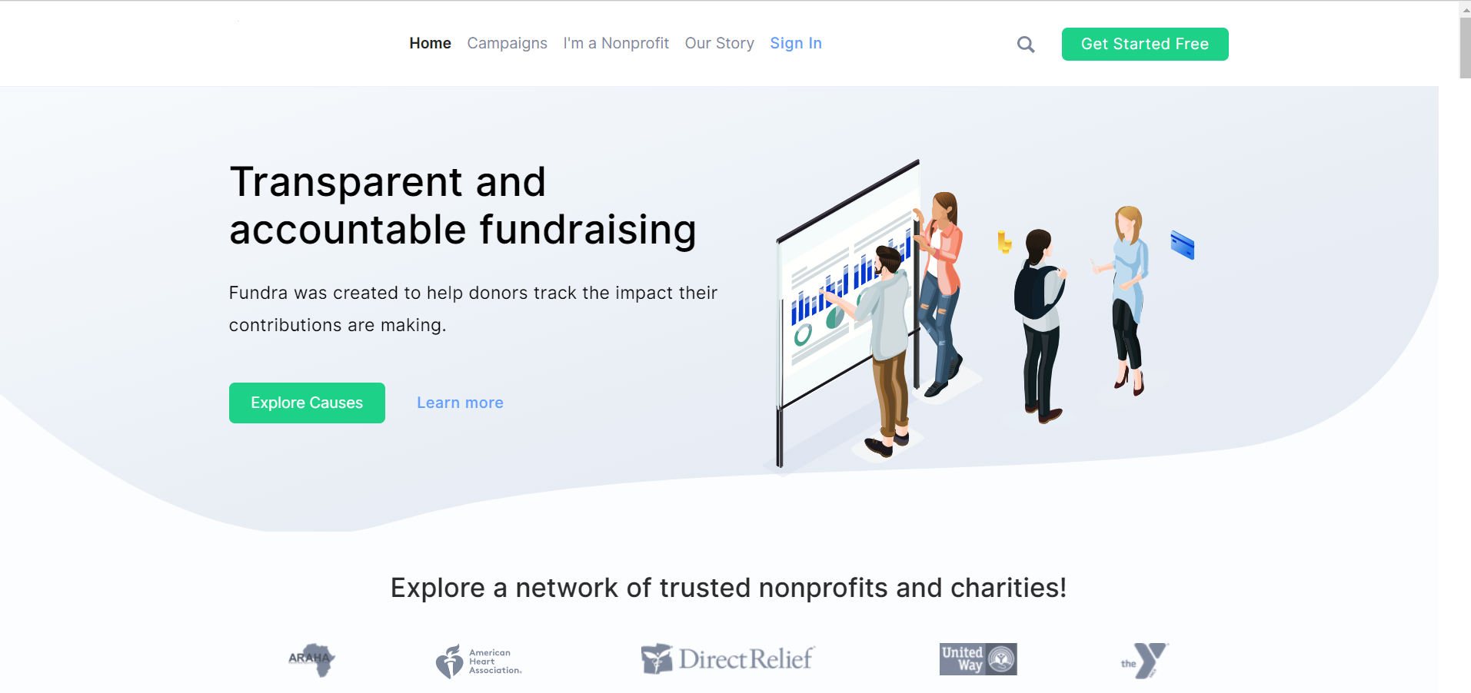

Slide 17
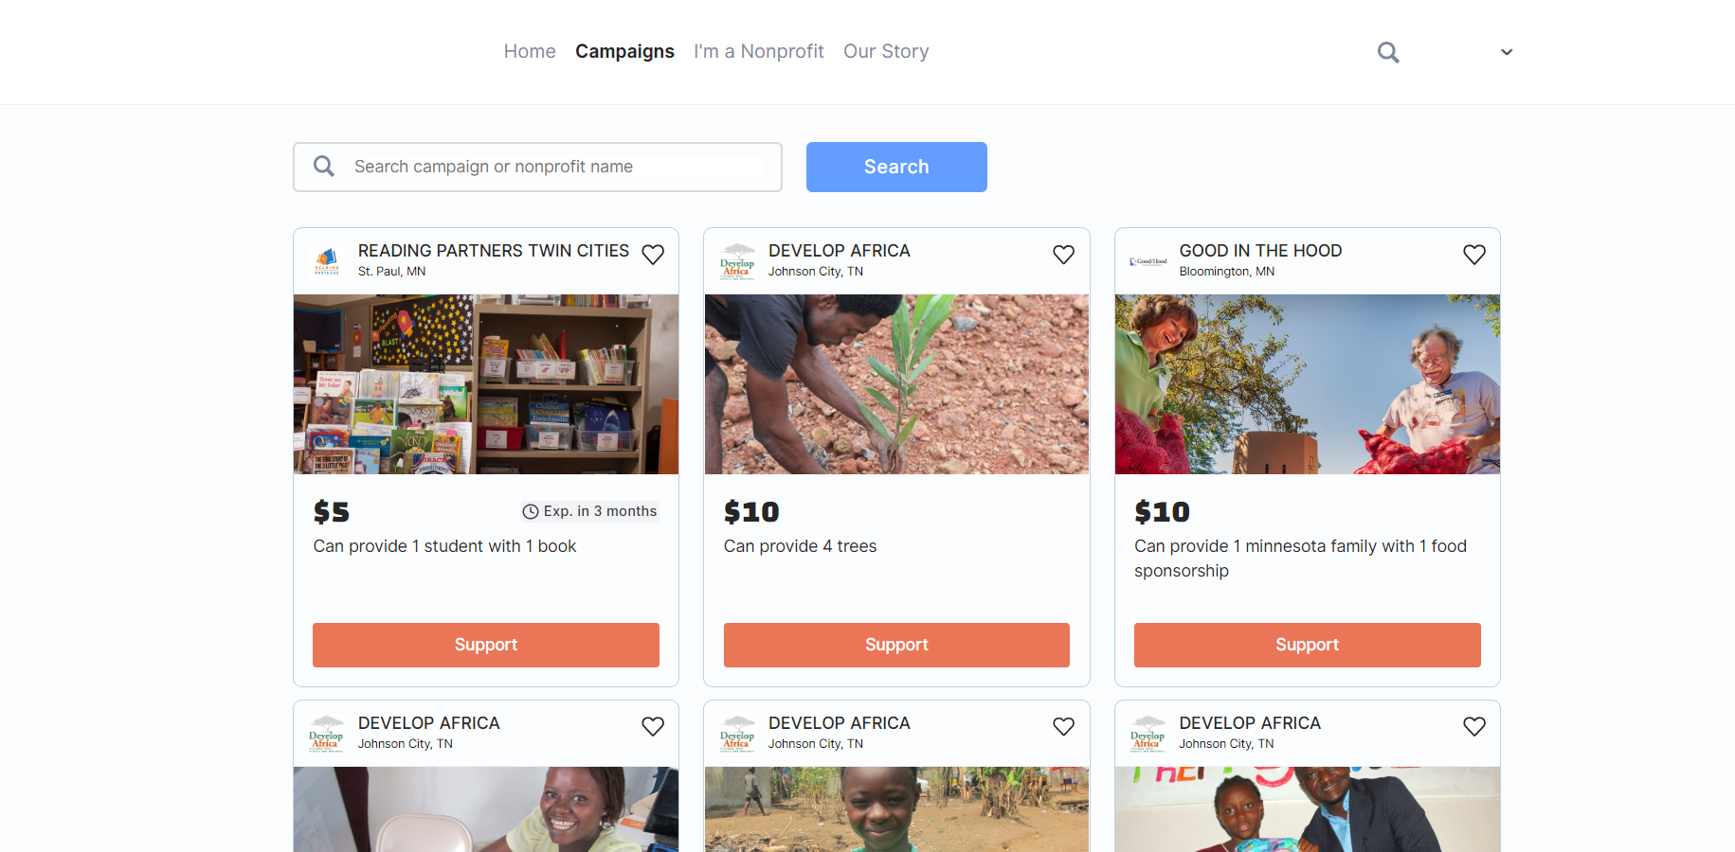

Slide 18
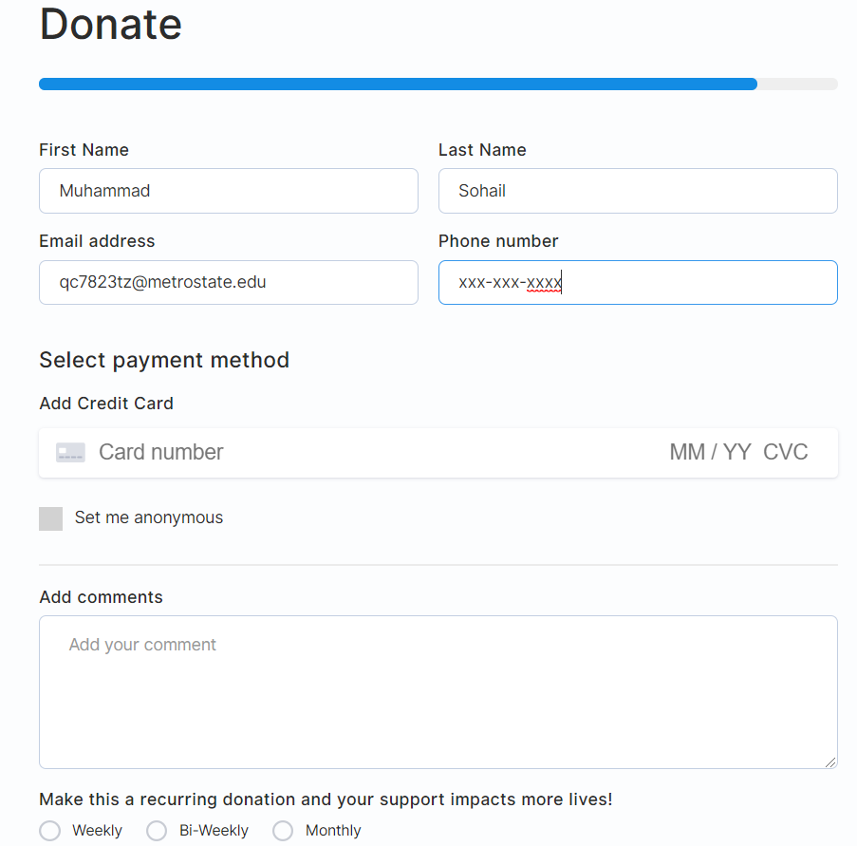

Slide 19
